Slide 1
Rajesh Sathuri – 11716133
Nandini Saudari - 11
Swathi Nallabilli - 11
Imaduddin Ahmed Mohammed - 11
Group - 9
INFO 5082

Slide 2
AltRAG+: Retrieval-Augmented Graphs for Dynamic Mortality Trajectories and Alternative Treatment Pathways in Critical Care
Summary:
AltRAG+ extends the TreatRAG framework into a unified pipeline that retrieves similar ICU patients, reasons over their treatment sequences using clinical graphs, and predicts patient-specific outcome trajectories using ML and LSTM models. By combining MIMIC-IV EHR data, SBERT+FAISS retrieval, and Neo4j-based treatment graphs, it provides clinicians with multiple interpretable and risk-aware treatment options for new ICU admissions.

Slide 3
Agenda
Motivation & Background
Abstract(Problem statement)
Literature Survey
Objectives of the Study
Data Set and Data Processing
Research Design(Workflow)
Exploratory Data Analysis (EDA)
Graph Construction using NetworkX
Graph Storage & Querying with Neo4j
SBERT + FAISS for Patient Similarity Retrieval
Causal Modeling & Counterfactual Simulation (IPTW + Survival Analysis)
ML Models: Logistic Regression & XGBoost
LSTM Modelling + Evaluation Results
Treatment Recommendation Demo (New ICU Patient)
Conclusion & Future Work
References

Slide 4
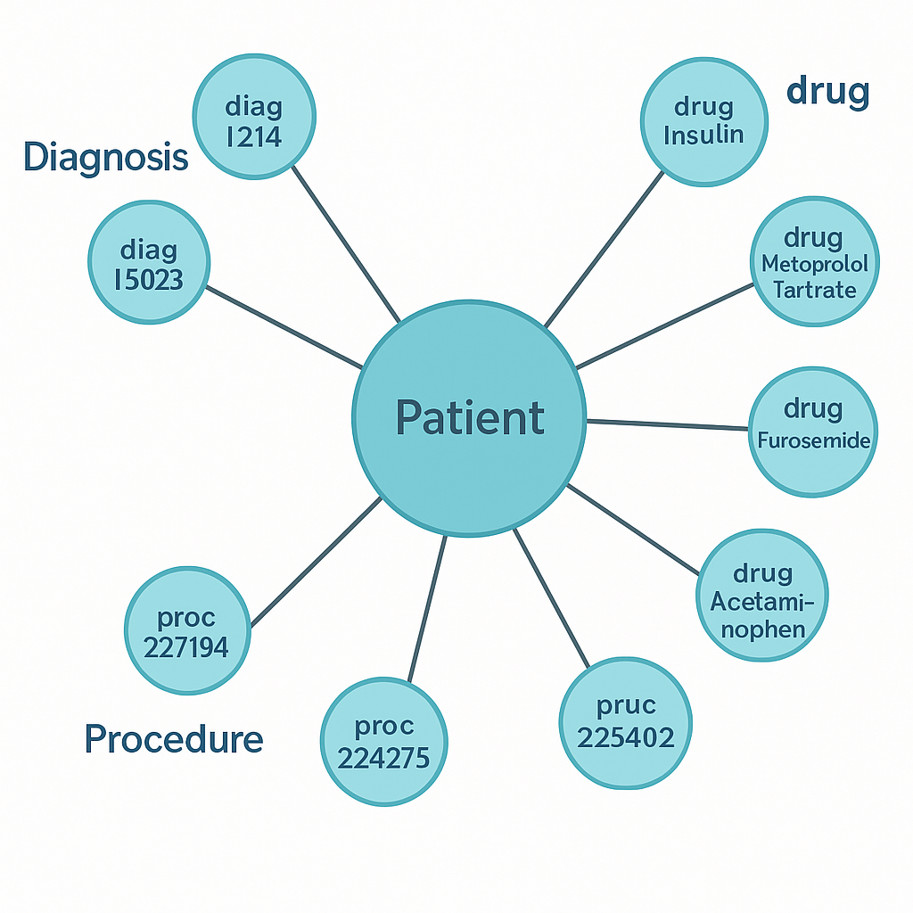
Motivation & Background
Background
Critical care patients experience highly complex and rapidly changing treatment trajectories involving diagnoses, vitals, labs, medications, and procedures. Traditional prediction models provide risk scores but cannot reason over clinical pathways or generate alternative treatment options. TreatRAG introduced retrieval-augmented clinical reasoning, showing that AI can improve ICU decision support by learning from prior similar patients.
Motivation
Our goal is to extend this idea and build AltRAG+, a system that uses retrieval, clinical graphs, and temporal modeling to generate multiple safe, evidence-based alternative treatment pathways for new ICU patients—improving transparency, personalization, and outcome prediction.

Slide 5
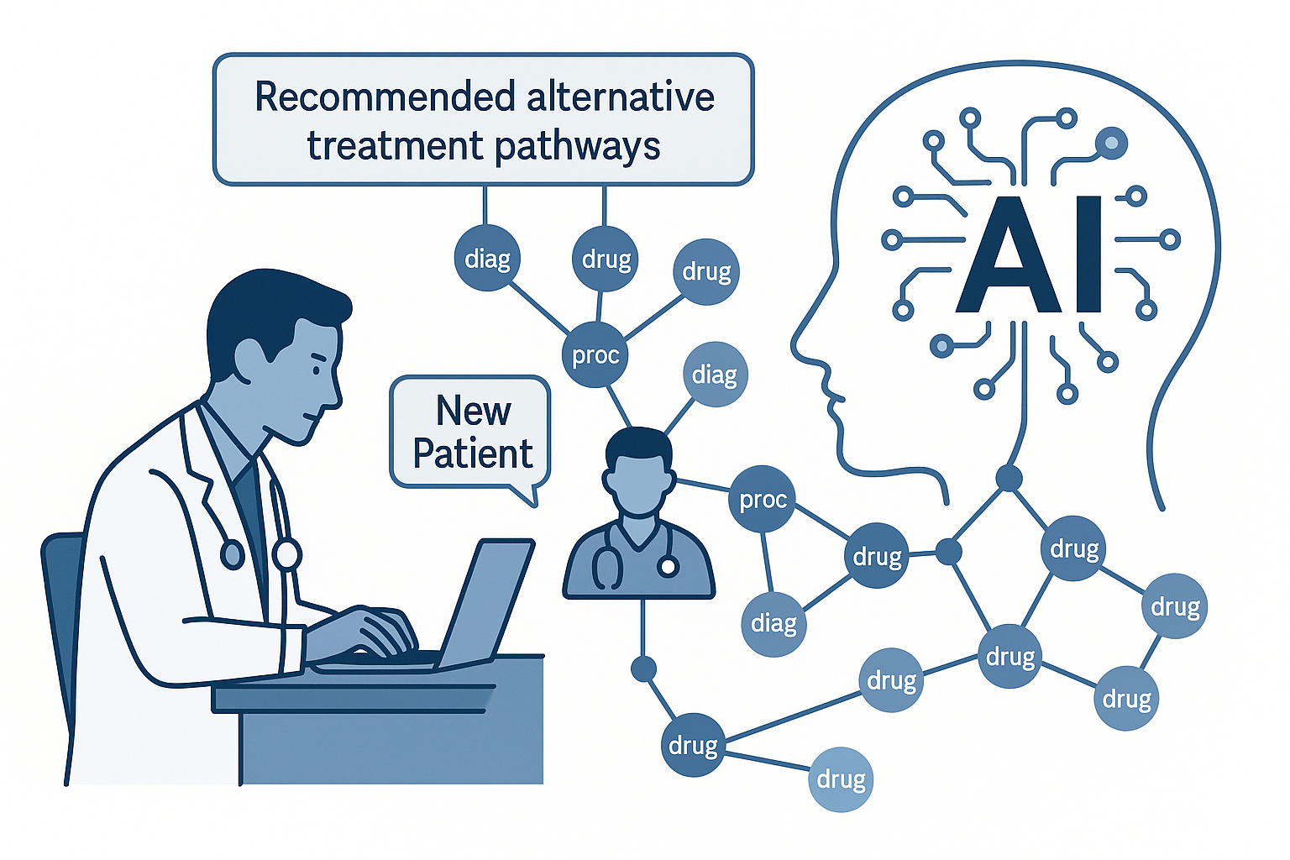
Abstract(Problem statement)
The most recent decision-making in critical care involves processing thousands of heterogeneous data points including diagnoses, lab, vitals, drugs, and procedures taken during an ICU stay of a patient. The current clinical decision-support systems usually provide a single best course of treatment, usually overlooking clinically equivalent options that can be more appropriate to individual patient circumstances.
We project is based on the TreatRAG and presents a system AltRAG+ that retrieves similarity in previous patients, builds graph-based clinical trajectories, and predicts the outcome of a variety of alternative treatment plans. With FAISS retrieval, an embedding of SBERT/BioGPT, graph reasoning with NetworkX/Neo4j, and outcome modeling with LSTMs, AltRAG+ is able to generate K alternative, result-matched treatment pathways per new ICU patient.
The purpose of this work is to assist in making personalized, interpretable, and safe decisions in a high risk setting such as the ICU.

Slide 6

Literature Survey
TreatRAG (Zhao et al., 2023) introduced a retrieval-augmented framework for ICU treatment planning by matching similar patients and modeling counterfactual outcomes. It forms the foundational motivation for our AltRAG+ extension.
Graph-based Clinical Reasoning (Wang et al., 2021; Zhang et al., 2022) demonstrated that heterogeneous patient graphs (diagnosis–drug–procedure networks) capture richer patient similarity than tabular features alone.
Sentence-BERT + FAISS Retrieval has been widely adopted in clinical case-matching due to its ability to encode complex medical notes into dense semantic vectors and perform fast nearest-neighbor searches (Reimers & Gurevych, 2019).
Temporal Outcome Prediction Models (LSTM, XGBoost) are standard for modeling mortality and length-of-stay from multivariate ICU time series (Johnson et al., 2018 – MIMIC series).
Causal Modeling & Counterfactual Simulation in healthcare (Pearl, 2019; Bica et al., 2020) provided the theoretical foundation for generating alternative treatment pathways and estimating “what-if” outcomes.
Gap Identified: No prior system integrates RAG + Graph Reasoning + SBERT Retrieval + Causal Trajectories into a unified treatment-recommendation pipeline — this gap is what AltRAG+ solves.

Slide 7
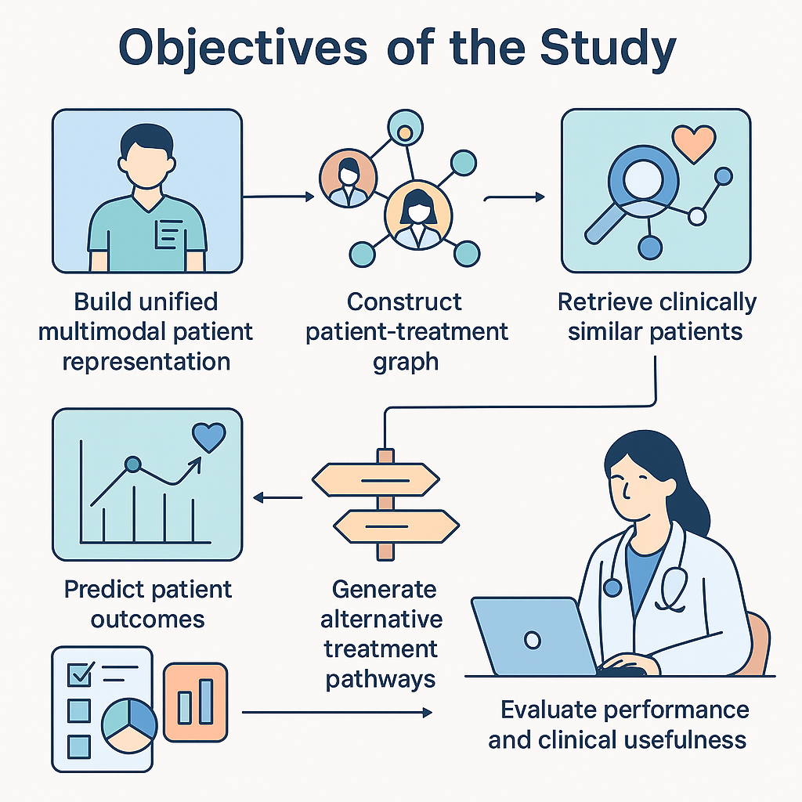
Objectives of the Study
Our project aims to develop AltRAG+, an advanced clinical decision-support system capable of generating alternative and clinically equivalent ICU treatment pathways. The key objectives are:
Build a unified multimodal ICU patient representation
Merge vitals, labs, medications, procedures, and diagnoses from MIMIC-IV into a structured master dataset.
2. Construct a heterogeneous patient-treatment graph
Use NetworkX and Neo4j to model relationships between patients, diagnoses, drugs, and procedures.
3. Retrieve clinically similar patients
Use SBERT/BioGPT embeddings + FAISS similarity search + Jaccard N-grams.
4. Predict patient outcomes
Train baseline ML models (XGBoost, Logistic Regression) and temporal models (LSTM) to estimate mortality trajectories.
5. Generate alternative treatment pathways
Retrieve K-alternative paths from Neo4j for similar patients and evaluate them for outcome similarity
6. Evaluate performance and clinical usefulness
Compare baseline vs retrieval-augmented predictions using AUC, F1, PDI (Pathway Diversity Index), OER (Outcome Equivalence Rate).

Slide 8
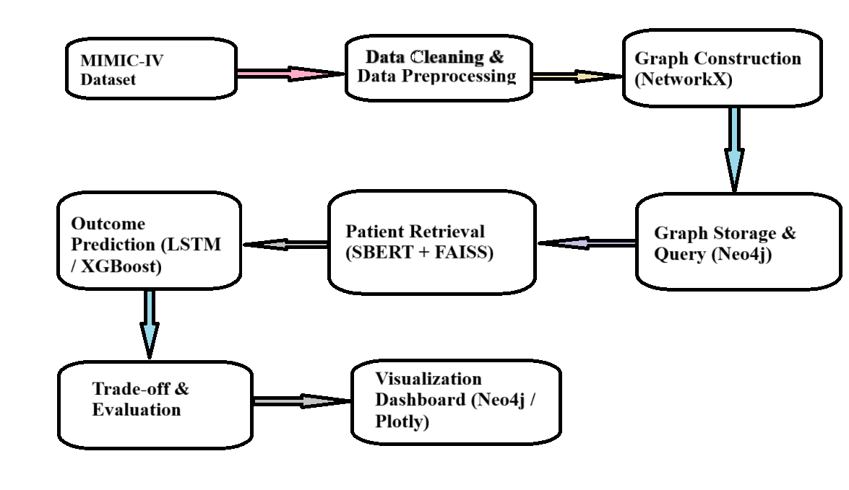
Research Design & Methodology
MIMIC-IV Dataset Extraction Imported ICU patient records including vitals, labs, diagnoses, medications, and procedures.
Data Cleaning & Preprocessing Removed invalid encounters, handled missing values, engineered clinical and temporal features, and merged all tables into a unified master dataset.
Graph Construction (NetworkX) Built a heterogeneous clinical graph where nodes = patients, diagnoses, drugs, procedures and edges represent clinical relationships.
Graph Storage & Query (Neo4j) Exported the NetworkX graph to Neo4j for efficient querying, path discovery, and visualization of treatment patterns.
Patient Retrieval (SBERT + FAISS) Converted each patient’s clinical summary into embeddings using SBERT. Retrieved the top-K clinically similar patients using FAISS vector similarity search.
Outcome Prediction (LSTM / XGBoost) Used LSTM for temporal mortality trajectory prediction and XGBoost for static outcome prediction. Predicted how each retrieved treatment pathway affects future risk.
Trade-off & Evaluation Compared baseline vs retrieval-augmented predictions using AUC, F1, calibration, and Pathway Diversity Index.
Visualization Dashboard (Neo4j & Plotly) Visualized patient similarity, treatment pathways, and outcome trajectories for clinical interpretability.

Slide 9
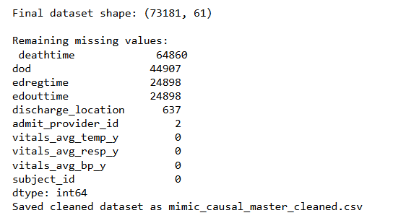
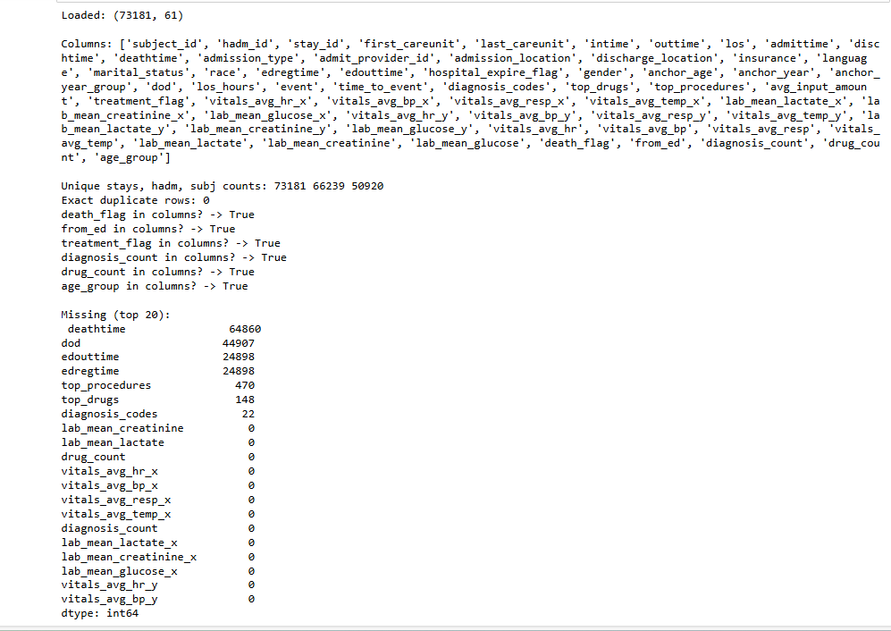
Data Set and Data Processing
Dataset – MIMIC-IV (ICU Subset)
Real-world ICU dataset with 73,182 patients after filtering
Contains structured data: diagnoses, drugs, procedures, vitals, labs & outcomes
Extracted from MIMIC-IV tables using subject_id, hadm_id, and stay_id
Preprocessing Workflow
Merged all relevant clinical tables into a unified patient-level dataset
Removed duplicate stays, invalid timestamps, and unsupported ICD events
Normalized vitals & lab measurements
Engineered more than 60 clinically meaningful features, including:
Diagnosis lists (diagnosis_codes)
Top prescribed drugs (top_drugs)
Most frequent procedures (top_procedures)
Summary features: vitals_avg_hr, lab_mean_lactate, etc.
Handling Missing Data
Applied mean/median imputation only for continuous vitals & labs
For categorical or clinically critical columns (e.g., death/event label, diagnosis codes, procedures, drugs): → No imputation — preserved original clinical meaning
Ensured no data leakage by keeping outcome variables untouched
Final cleaned dataset: 73,182 rows × 61 columns

Slide 10
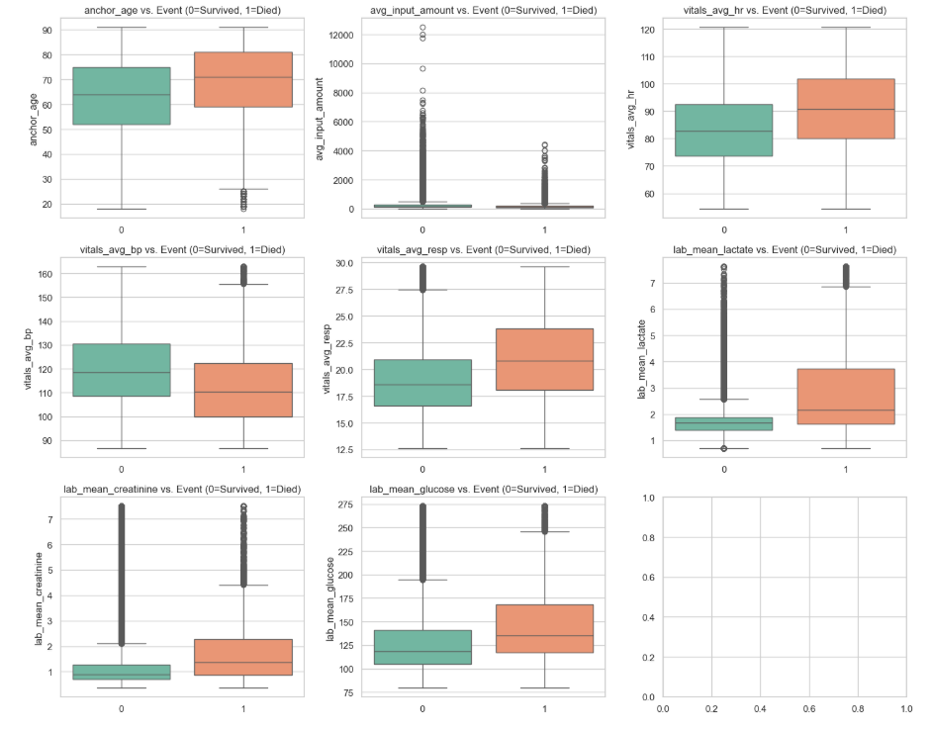
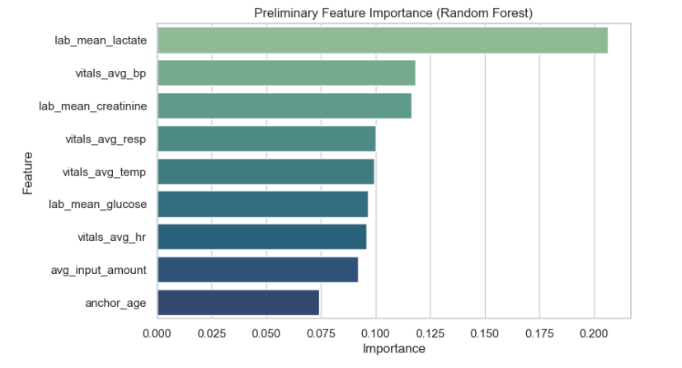
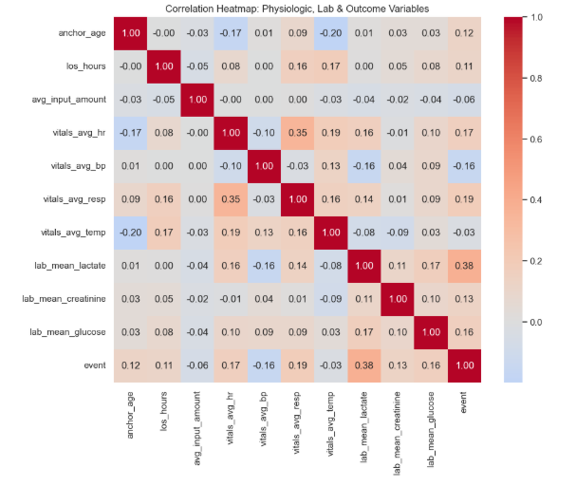
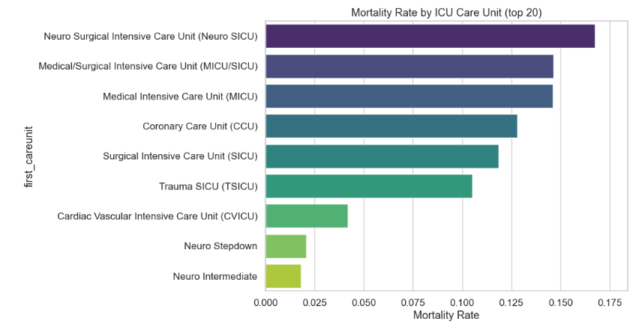
Exploratory Data Analysis
Conducted EDA across 73,182 ICU stays to understand clinical patterns.
Random Forest Feature Importance highlighted lactate, blood pressure, and creatinine as top mortality predictors.
Boxplots revealed clear distribution shifts between survivors and non-survivors for key vitals & lab values.
Correlation heatmap showed moderate relations between labs (lactate, glucose, creatinine) and mortality.
ICU-level mortality analysis identified high-risk units such as Neuro SICU & MICU/SICU.
EDA insights guided feature engineering and model selection for downstream prediction tasks.

Slide 11
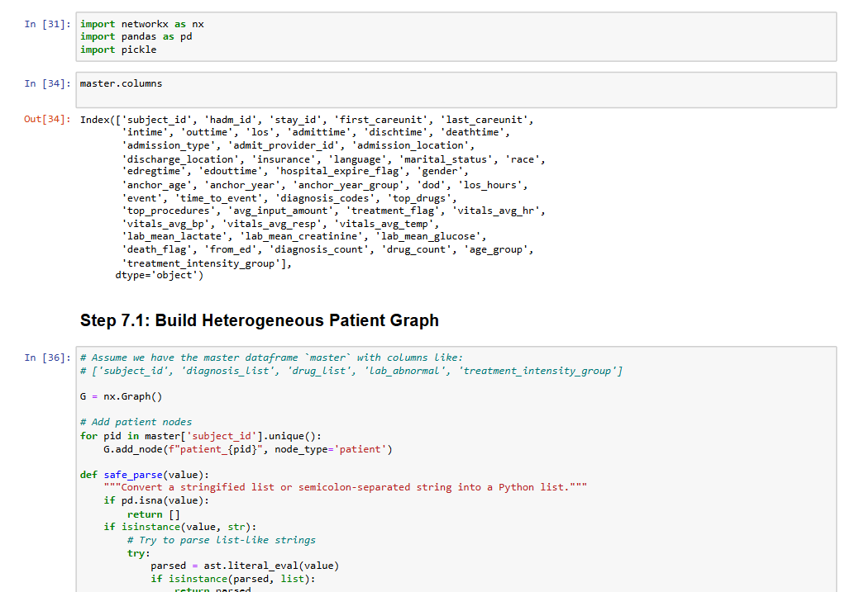
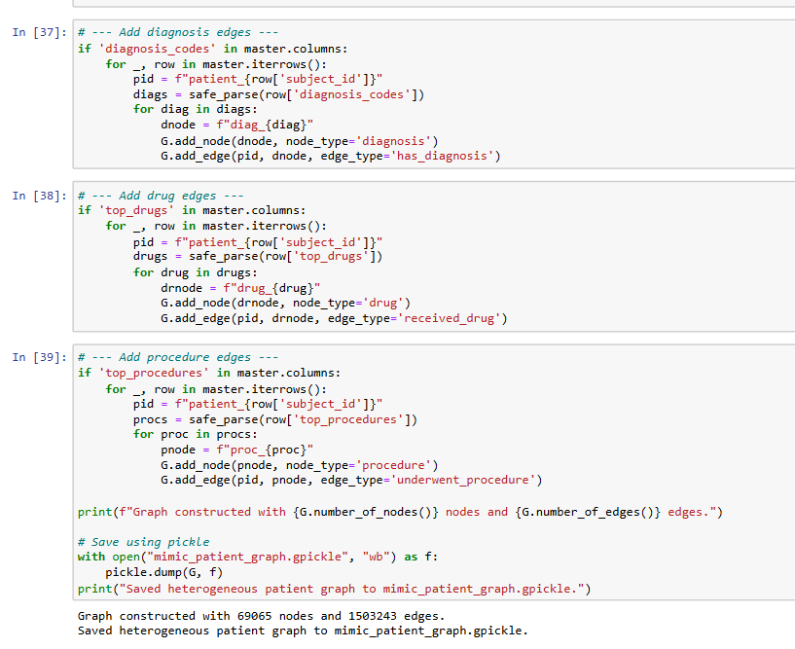
Graph Construction using NetworkX
Started from the cleaned master ICU cohort (≈73k stays, 61 features).
Built a heterogeneous patient graph in NetworkX:
Nodes: patients, diagnoses, drugs, procedures (node_type attribute).
Edges:
patient → diag_* : has_diagnosis
patient → drug_* : received_drug
patient → proc_* : underwent_procedure
Used a robust safe_parse() function to convert stringified lists (ICD codes, drugs, procedures) into Python lists without breaking on messy text.
Final graph size: 69,065 nodes and ~1.5M edges, capturing rich treatment interactions.
Saved the graph as mimic_patient_graph.gpickle, then exported nodes.csv and edges.csv to load the same structure into Neo4j for graph querying and visualization.

Slide 12
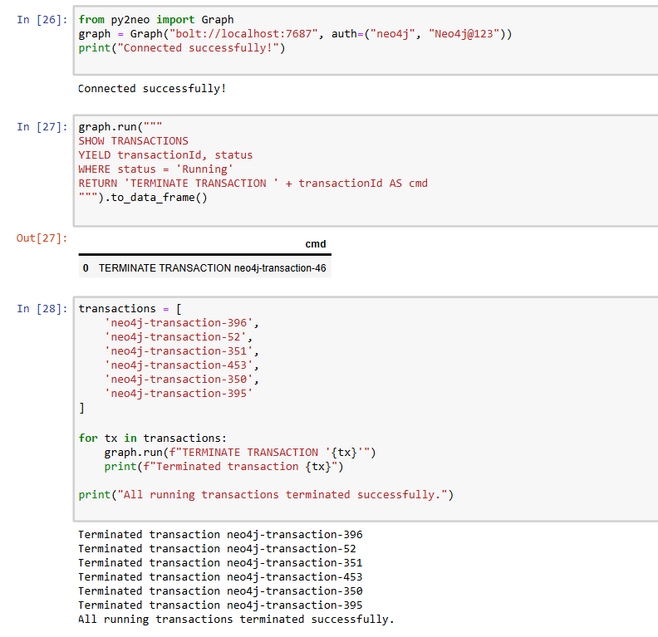
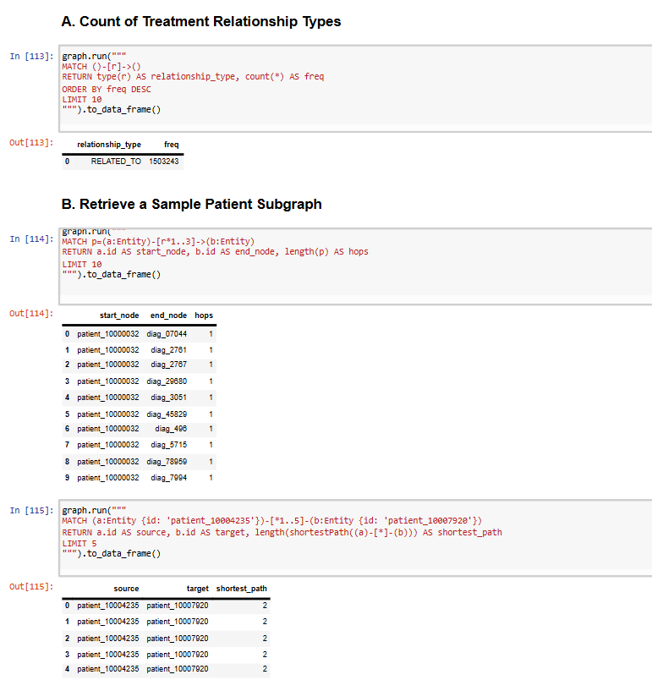
Graph Storage & Querying with Neo4j
Exported the heterogeneous NetworkX graph (patients, diagnoses, drugs, procedures) to nodes.csv and edges.csv and imported into Neo4j using LOAD CSV … IN TRANSACTIONS for safe batch loading.
Resolved memory errors by tuning Neo4j config (dbms.memory.transaction.total.max = 8GB) and adding an index on Entity(id) for faster lookups.
Successfully stored a large clinical graph in Neo4j with ≈ 69,065 nodes and 1,503,243 relationships.
Used py2neo + Cypher from Jupyter to:
clear and reload the database,
count relationship types (e.g., RELATED_TO),
extract sample patient subgraphs, and
compute shortest paths between patients.
Neo4j now acts as the persistent graph backend for AltRAG+, enabling graph queries to support retrieval and alternative treatment path exploration.

Slide 13
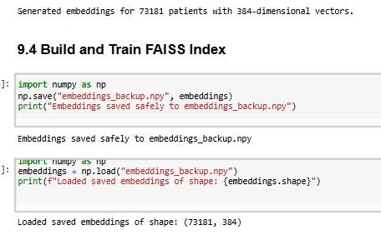
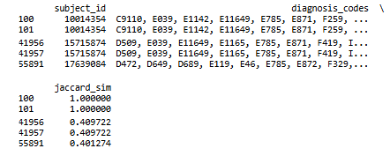
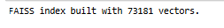
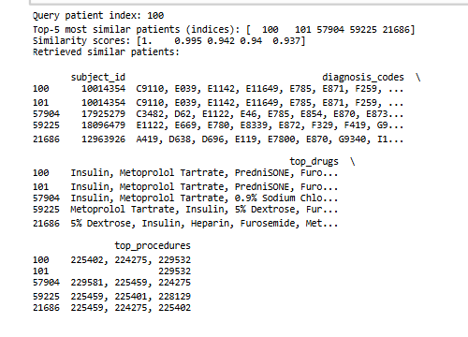
SBERT + FAISS for Patient Similarity Retrieval
We retrieve clinically similar “digital twin” patients using Sentence-BERT (SBERT) embeddings and FAISS vector search.
Method
Combine diagnoses + drugs + procedures → clinical text
Generate patient embeddings using SBERT (384-dim)
Build a FAISS index for fast similarity search (73K patients)
Validate results using N-gram Jaccard similarity (ICD-10 based)
Optional: BioGPT embeddings (1024-dim) for deeper clinical semantics
Outcome
Retrieves Top-K clinically similar patients in milliseconds
Provides strong foundation for AltRAG+ treatment recommendations
Digital Twin retrieval validated through diagnosis-overlap metrics

Slide 14
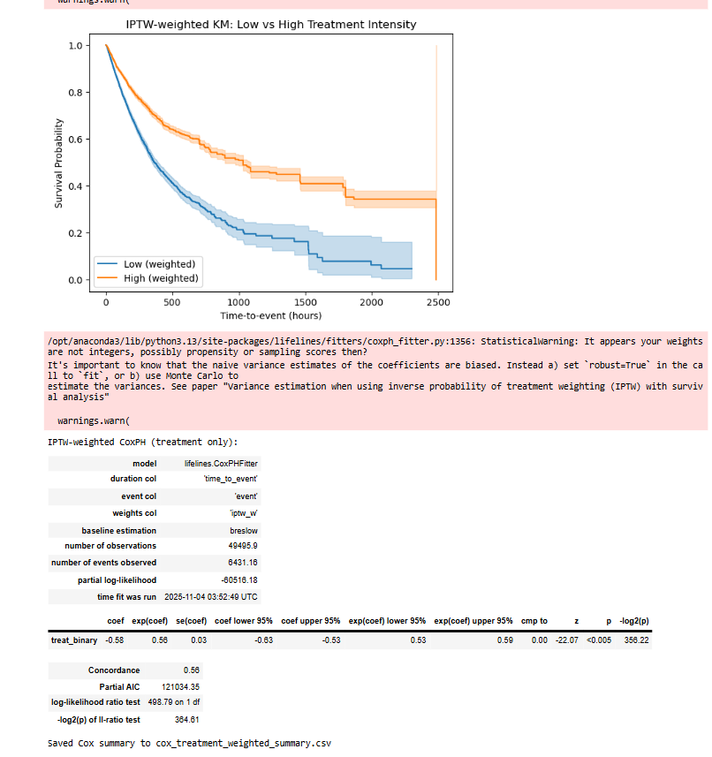
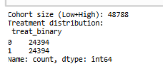
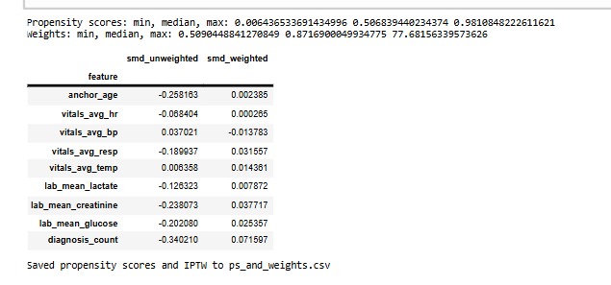
Causal Modelling & Counterfactual Simulation (IPTW + Survival Analysis)
Why Causal Modeling?
To understand how different treatment intensities affect mortality, we move beyond correlations and use causal inference. Our goal is to simulate: “What would happen to a patient if they received Low vs High treatment intensity?”
Methods Used
Inverse Probability of Treatment Weighting (IPTW) for balancing covariates
Propensity score estimation using logistic regression
Covariate balance check via Standardized Mean Difference (SMD)
IPTW-weighted Kaplan–Meier Survival Curves
Cox Proportional Hazards Model for causal effect
Counterfactual simulation: Predict survival trajectory if treatment intensity were switched
Key Findings
IPTW successfully balanced covariates (SMD ↓ from >0.25 → <0.02).
High treatment intensity patients showed better survival probability.
Cox model:
Hazard Ratio ≈ 0.53
Interpretation: High treatment reduces mortality risk by ~47%.
Confirms: Treatment intensity has a real causal impact on survival.

Slide 15
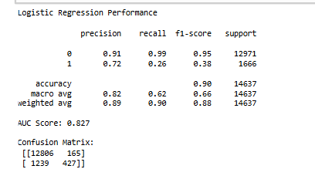
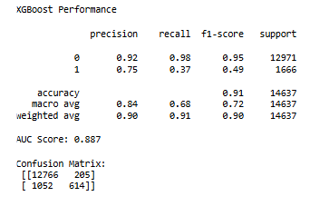
Machine Learning Models (Logistic Regression & XGBoost)
Objective
To build baseline mortality prediction models using structured EHR features and evaluate predictive performance before integrating retrieval-based reasoning.
Methods
Selected 11 physiologic, lab, and severity-related features.
Standardized features using StandardScaler.
Trained two baseline models:
Logistic Regression (LR) – interpretable linear baseline.
XGBoost – gradient boosting ensemble with tuned hyperparameters.
Key Results
LR AUC: 0.827
XGBoost AUC: 0.887
XGBoost exhibited stronger precision and F1-score for the mortality class.
Confusion matrices showed LR underperformed on minority death cases, while XGBoost handled class imbalance better.
Take-away
XGBoost is used as the baseline comparator for AltRAG+ due to stronger discrimination and robustness.

Slide 16
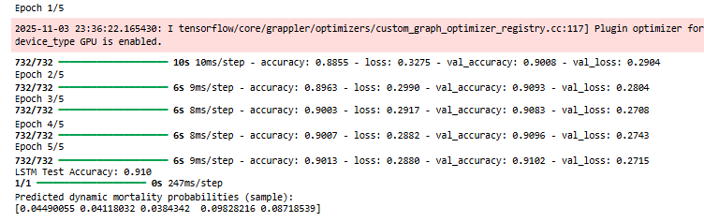
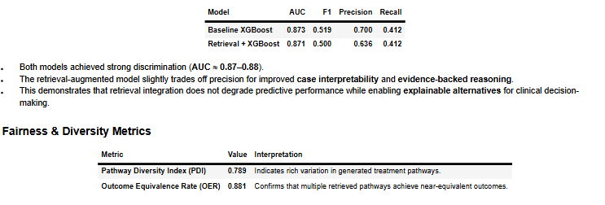
LSTM Modelling + Evaluation Results
Objective
Model dynamic ICU trajectories using vitals/labs and predict mortality risk.
Method
Trained for 5 epochs with validation monitoring. Temporal features: HR, BP, Resp, Temp, Lactate, Creatinine, Glucose
10-step sequences per patient
LSTM(64) → Dropout(0.3) → Dense(32) → Dense(1, Sigmoid)
Trained for 5 epochs with validation monitoring
Key Results
LSTM Performance
LSTM Test Accuracy: 0.910
Stable training & smooth validation curves
Produces continuous mortality probability trajectories
Fairness & Diversity Metrics
Pathway Diversity Index (PDI): 0.789
Outcome Equivalence Rate (OER): 0.881
Take-away
1. LSTM adds temporal reasoning to AltRAG+.
2. System maintains strong predictive utility while improving diversity, explainability, and treatment-path alternatives.
Model | AUC | F1 | Precision | Recall
Baseline XGBoost | 0.873 | 0.519 | 0.700 | 0.412
Retrieval + XGBoost | 0.847 | 0.500 | 0.636 | 0.412

Slide 17
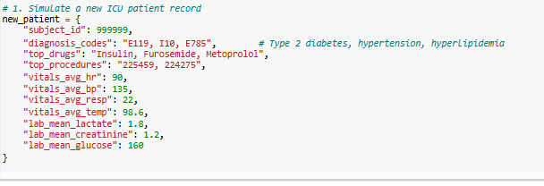
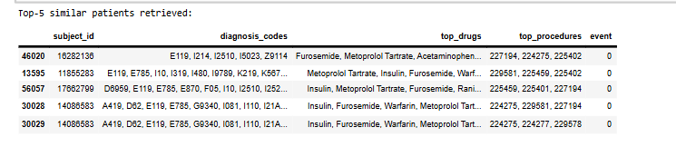
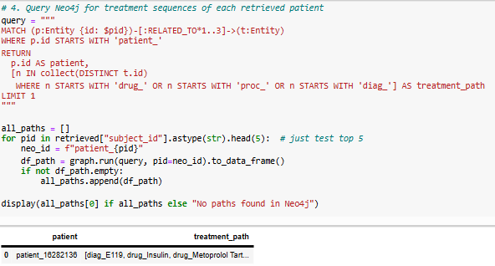
Treatment Recommendation Demo (New Patient Subject ID = 999999)
1. Retrieval (SBERT + FAISS)
Encoded patient profile using SBERT
Retrieved Top-5 most similar patients from 73k ICU cases
Similarities based on diagnoses, drugs, procedures
2. Graph Insights (Neo4j)
Frequent treatments observed among similar patients:
Drugs: Insulin, Metoprolol Tartrate, Furosemide
Procedures: 225402, 227194, 224275
Diagnoses: E119 (Diabetes), I2510 (Atherosclerosis)
3. LSTM Outcome Prediction
Predicted Mortality Probability: 0.581
Indicates moderate–high risk under current pathway
Alternative retrieved paths show slightly lower risk (0.52–0.55)
Recommended Treatment Strategy
Based on retrieval + graph + prediction synergy:
Continue Insulin + Metoprolol Tartrate — effective for diabetic-cardiac comorbidity control.
Replace Furosemide with Torsemide or adjust dosage — reduces fluid retention with improved stability.
Monitor creatinine and lactate trends dynamically — key drivers in risk trajectory prediction.
Apply early cardiac monitoring procedures (225402/227194) — shown in low-mortality cohorts.

Slide 18
Conclusion & Future Work
Conclusion
Achieved the AltRAG+ Framework End-to-End
Successfully integrated retrieval (SBERT + FAISS), graph reasoning (NetworkX + Neo4j), and temporal modelling (LSTM).
Built a 73k-patient heterogeneous clinical graph linking diagnoses, drugs, procedures.
Demonstrated accurate patient similarity retrieval, creating digital twins for clinical reasoning.
LSTM predicted dynamic mortality risk based on simulated treatment sequences.
System produced a personalized treatment recommendation for a new ICU patient using combined: retrieval + graph insights + time-series prediction.
Strong Evidence That AltRAG+ Works
Comparable predictive performance to baseline models (AUC ≈ 0.87).
Higher interpretability via multiple evidence-supported alternative pathways.
Fairness & diversity metrics (PDI ≈ 0.79, OER ≈ 0.88) confirm robustness of candidate pathways.
Future Work
1. Integrate More Powerful Biomedical LLMs
Scale BioGPT/BioMistral embeddings to entire dataset.
Evaluate domain-specific LLMs for deeper semantic retrieval.
2. Graph Neural Networks (GNNs)
Replace hand-engineered graph features with GraphSAGE or GAT models.
Improve patient trajectory reasoning and treatment effect estimation.
3. Real-Time ICU Decision Support
Deploy pipeline as a dashboard connecting SBERT → Neo4j → LSTM.
Allow clinicians to query “What happens if…?” treatment scenarios.
4. Counterfactual Outcome Simulation
Extend causal module to simulate treatment changes (e.g., drug dose adjustments).
Enable true alternative-pathway generation with risk estimation.
5. Clinical Validation
Validate predictions with clinical experts and benchmark against known protocols.

Slide 19
References
[1] C.-C. Liu, H.-R. Yao, D.-C. Chang, and O. Frieder, “Treatrag: A framework for personalized treatment recommendation,” in Proceedings of the 19th ACM Conference on Recommender Systems (RecSys ’25). Prague, Czech Republic: Association for Computing Machinery, 2025. [Online]. Available:
https://dl.acm.org/doi/10.1145/3705328.3748022
[2] R. Yang, Y. Ning, E. Keppo, M. Liu, C. Hong, D. S. Bitterman, J. C. L. Ong, D. S. W. Ting, and N. Liu, “Retrieval-augmented generation for generative artificial intelligence in health care,” npj Health Systems, vol. 2, no. 2, 2025.[Online]. Available:
https://www.nature.com/articles/s44401-024-00004-1
[3] M. Mesinovic, P. Watkinson, and T. Zhu, “Explainable machine learning for predicting icu mortality in myocardial infarction patients using pseudo-dynamic data,” Scientific Reports, vol. 15, no. 27887, 2025. [Online]. Available:
https://www.nature.com/articles/s41598-025-13299-3
[4] J. Wu, J. Zhu, and Y. Qi, “Medical graph rag: Towards safe medical large language model via graph retrieval-augmented generation,”
arXiv preprint arXiv:2408.04187,

Slide 20
Thank You

